Slide 1

Pc Parts Picker Website
By: Anton Miguel R. Cariño

Slide 2
OBJECTIVES
01
02
03
04
Parts Picking
Price Check
Free to pick parts and build own’s desired PC
Shows the prices of desired parts, varies from chosen store
Compatibility
Availability
Selection of parts shows which is compatible with each other
Able too see if the desired part is available in the store selection

Slide 3
CONCEPT
PROJECT 01
The idea of being able to plan your desired pc build, without the need of opening tons of websites, just to search for which part is compatible with which, how much is the part in this store compared to other stores, or the availability of it.
All done on a single website, providing you accurate information of your desired parts/peripherals on just one tab. Virtually creating your dream pc so you can plan ahead. This is what the Idea of pc parts picker website is built upon.

Slide 4
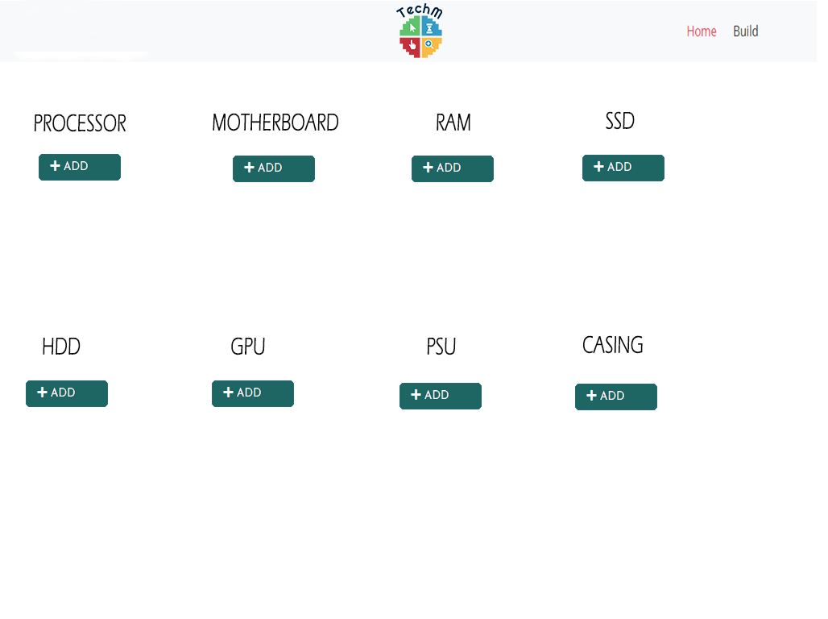
Sample Mockup Design

